Slide 1


<Trương Nhã Bình>
<11/01/2024>

Slide 2

Outline
Executive Summary
Introduction
Methodology
Results
Conclusion
Appendix

Slide 3
Executive Summary
Summary of methodologies
Data Collection through API
Data Collection with Web Scraping
Data Wrangling
Exploratory Data Analysis with SQL
Exploratory Data Analysis with Data Visualization
Interactive Visual Analytics with Folium
Machine Learning Prediction
Summary of all results
Exploratory Data Analysis
Interactive analytics
Predictive Analytics

Slide 4
Introduction
Project background and context
Space X advertises Falcon 9 rocket launches on its website with a cost of 62 million dollars; other providers cost upward of 165 million dollars each. By reusing the first stage, Space X can save more than the others. So, we can determine the cost of a launch if the first stage will land. This information can be used if an alternate company wants to bid against space X for a rocket launch. This goal of the project is to create a machine learning pipeline to predict if the first stage will land successfully.

Slide 5
Introduction
Problems to find answers
What factors determine the successful landing of a rocket?
Which interaction features determine the success rate of a successful landing?
Which operating conditions the rocket needs to be in place to ensure a successful landing program?

Slide 6

Section 1

Slide 7
Methodology
Data collection methodology:
By using SpaceX API
By Web scraping from Wikipedia
Perform data wrangling
Using One – hot encoding method to transform categorical features to numerical features
Perform exploratory data analysis (EDA) using visualization and SQL
Perform interactive visual analytics using Folium and Plotly Dash
Perform predictive analysis using classification models
How to build, tune and evaluate classification models

Slide 8
Data Collection
We will perform get request in the requests library to obtain the launch data and get the data from the Space X API. Our result will be a list of Json objects. We will use .json normalize() to turn it into a pandas dataframe.
We also can use the Python BeautifulSoup package to web scrape from Wikipedia for Falcon 9 launch records. Then we will need to parse the data and convert them into a pandas dataframe for further visualization and analysis.
Next, we will clean the data, check for missing values and fill in missing values where necessary.

Slide 9
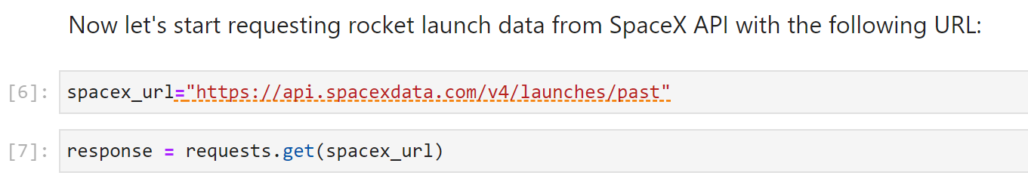
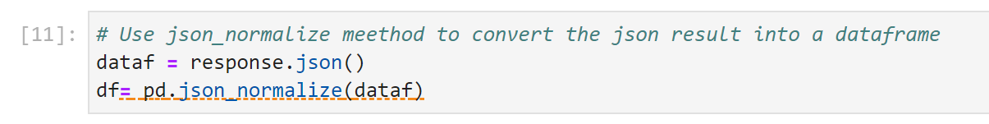
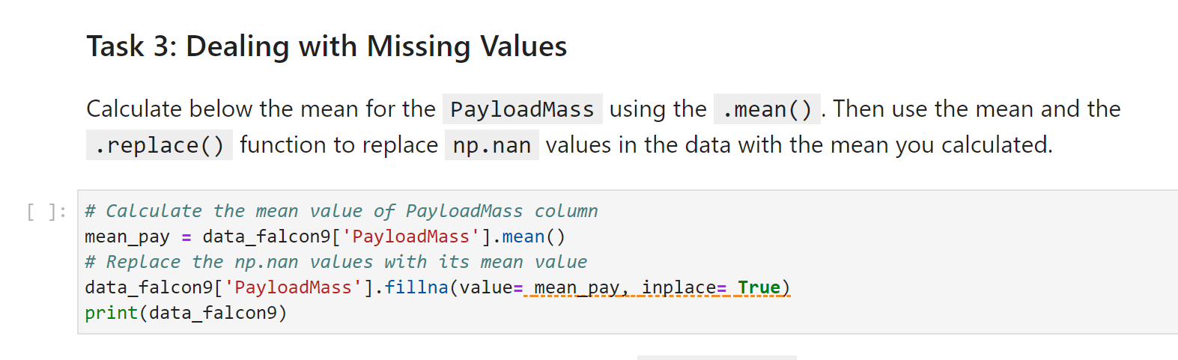
Data Collection – SpaceX API
We used requests.get to the SpaceX API to collect data; used .json_nomalize() to convert json result into a dataframe;
We cleaned the requested data and did some basic data wrangling and formatting.
https://github.com/truong-nha-binh/test-repo/blob/main/jupyter-labs-spacex-data-collection-api%20(2).ipynb

Slide 10
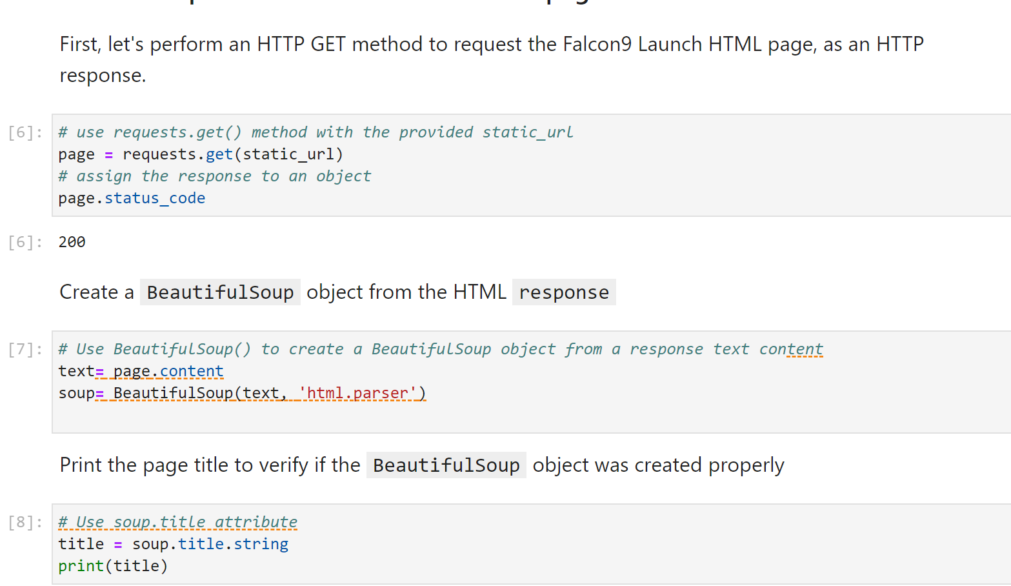
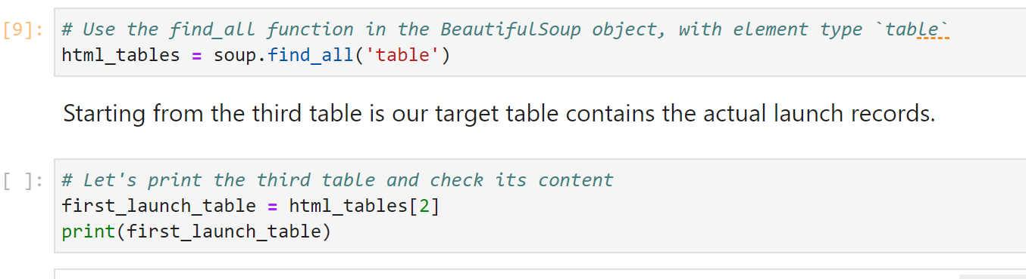
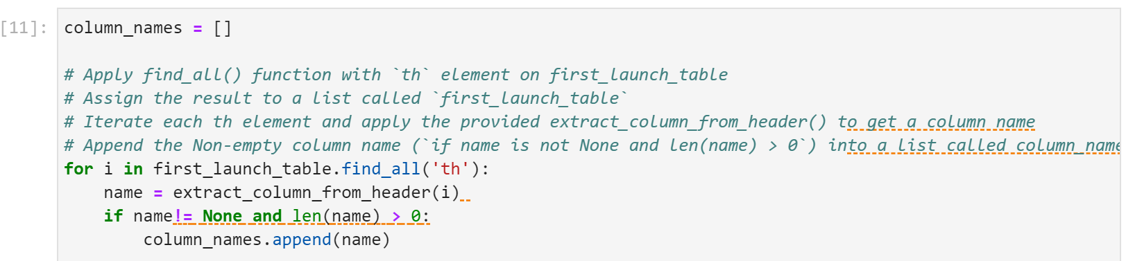
Data Collection - Scraping
We applied web scrapping to web scrap Falcon 9 launch records with BeautifulSoup
We parsed the table and converted it into a pandas dataframe
https://github.com/truong-nha-binh/test-repo/blob/main/jupyter-labs-webscraping%20(3).ipynb

Slide 11

Data Wrangling
We performed exploratory data analysis and determined the training labels.
We calculated the number of launches at each site, and the number and occurrence of each orbit
We created landing outcome label from outcome column and exported the results to csv
https://github.com/truong-nha-binh/test-repo/blob/main/labs-jupyter-spacex-Data%20wrangling%20(1).ipynb

Slide 12
EDA with Data Visualization
We explored the data by visualizing the relationship between flight number and launch site, payload and launch site, success rate of each orbit type, flight numbers and orbit type, the launch success yearly trend.
https://github.com/truong-nha-binh/test-repo/blob/main/jupyter-labs-eda-dataviz_final.ipynb

Slide 13
EDA with SQL
We loaded the SpaceX dataset into a SQL database without leaving the Jupyter notebook.
We applied EDA with SQL to get insight from the data. We wrote queries to find out for instance
The names of unique launch sites in the space mission.
The total payload mass carried by boosters launched by NASA (CRS)
The average payload mass carried by booster version F9 v1.1
The total number of successful and failure mission outcomes
The failed landing outcomes in drone ship, their booster version and launch site names.
https://github.com/truong-nha-binh/test-repo/blob/main/jupyter-labs-eda-sql-coursera_sqllite_FINAL.ipynb

Slide 14
Build an Interactive Map with Folium
We marked all launch sites, and added map objects such as markers, circles, lines to mark the success or failure of launches for each site on the folium map.
We assigned the feature launch outcomes (failure or success) to class 0 and 1.i.e., 0 for failure, and 1 for success.
Using the color-labeled marker clusters, we identified which launch sites have relatively high success rate.
We calculated the distances between a launch site to its proximities. We answered some questions for instance:
Are launch sites near railways, highways and coastlines?
Do launch sites keep certain distance away from cities?
https://github.com/truong-nha-binh/test-repo/blob/main/lab_jupyter_launch_site_location.jupyterlite_FINAL.ipynb

Slide 15
Build a Dashboard with Plotly Dash
We built an interactive dashboard with Plotly dash
We plotted pie chart showing the total launches by a certain site
We plotted scatter graph showing the relationship between Outcome and Payload Mass (Kg) for the different booster version.
https://github.com/truong-nha-binh/test-repo/blob/main/spacex_dash_app%20(1).py

Slide 16
Predictive Analysis (Classification)
We loaded the data using numpy and pandas, transformed the data, split our data into training and testing.
We built different machine learning models and tuned different hyperparameters using GridSearchCV.
We used accuracy as the metric for our model, improved the model using feature engineering and algorithm tuning.
We found the best performing classification model.
https://github.com/truong-nha-binh/test-repo/blob/main/SpaceX_Machine_Learning_Prediction_Part_5.jupyterlite.ipynb

Slide 17
Results
Exploratory data analysis results
Interactive analytics demo in screenshots
Predictive analysis results

Slide 18

Section 2

Slide 19
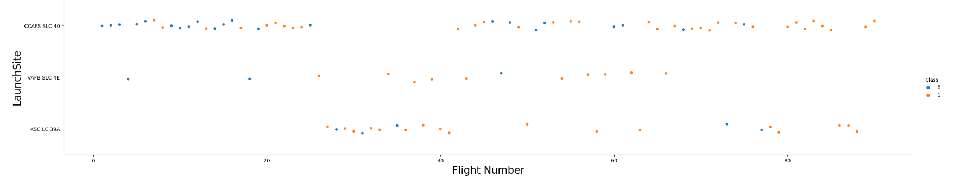
Flight Number vs. Launch Site
Scatter plot of Flight Number vs. Launch Site
We can see from the plot that the larger the flight amount at a launch site, the greater the success rate at a launch site.

Slide 20
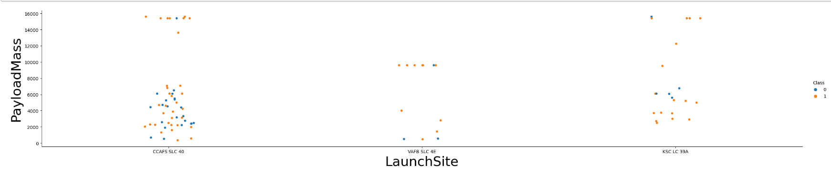
Payload vs. Launch Site
Scatter plot of Payload vs. Launch Site
For launch Site CCAFS SLC 40, the rocket with greater payload mass had a higher success rate

Slide 21
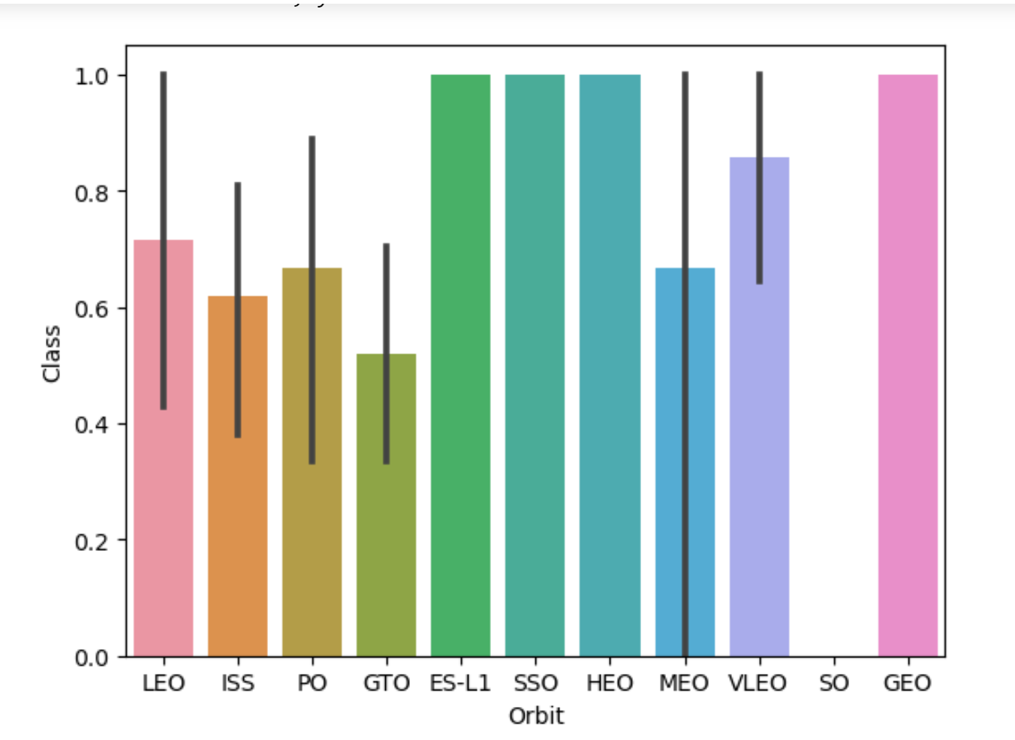
Success Rate vs. Orbit Type
A bar chart for the success rate of each orbit type
We can see from the plot that ES-L1, SSO, HEO, SSO, GEO and VLEO had the most success rate.

Slide 22
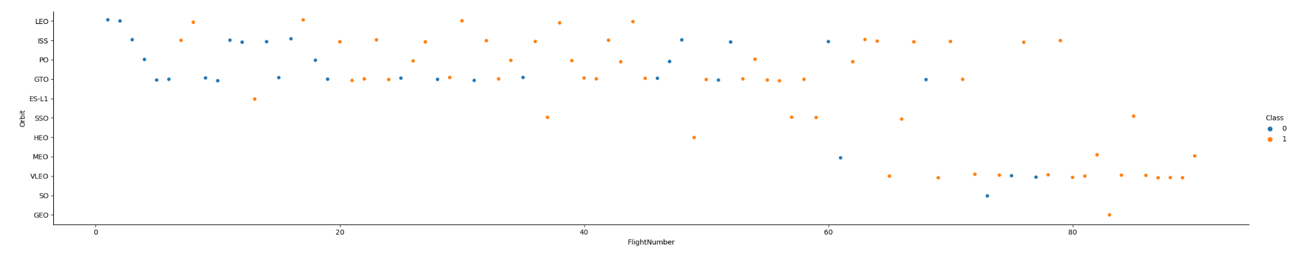
Flight Number vs. Orbit Type
Scatter point of Flight number vs. Orbit type
In the LEO orbit, success is related to the number of flights.
In the GTO orbit, there is no relationship between flight number and the orbit.

Slide 23
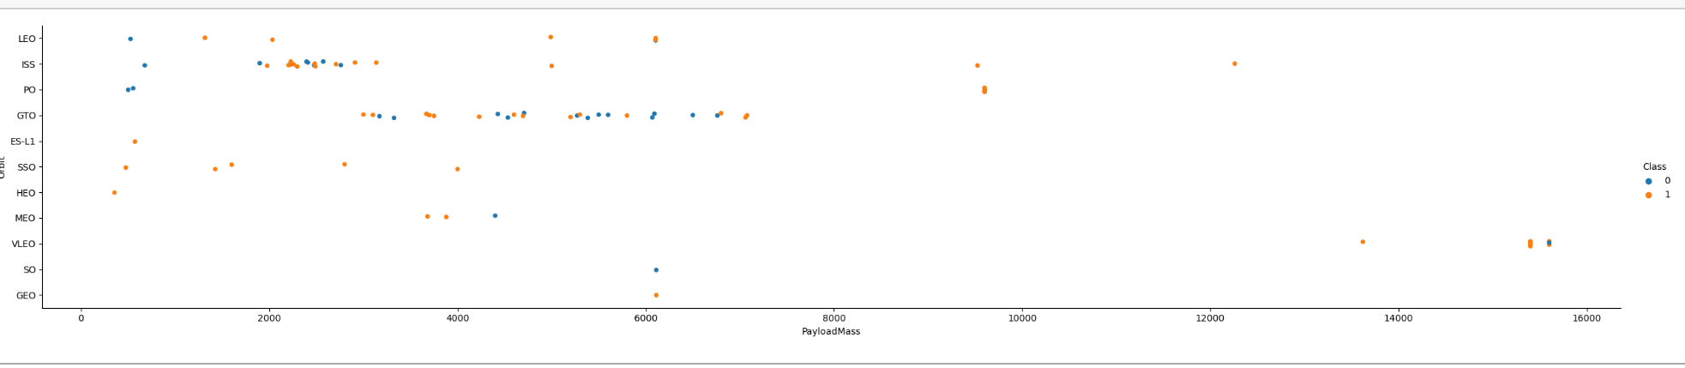
Payload vs. Orbit Type
Scatter point of payload vs. orbit type
With heavy payloads, the successful landing are more for PO, LEO and ISS orbits.

Slide 24
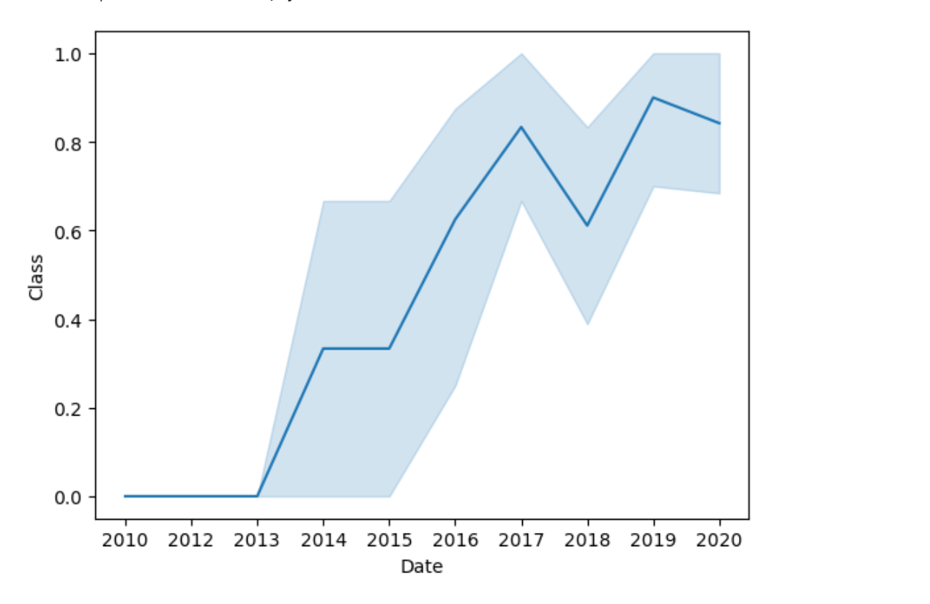
Launch Success Yearly Trend
A line chart of yearly average success rate
We can observe in the plot that success rate since 2013 kept on increasing till 2020.

Slide 25
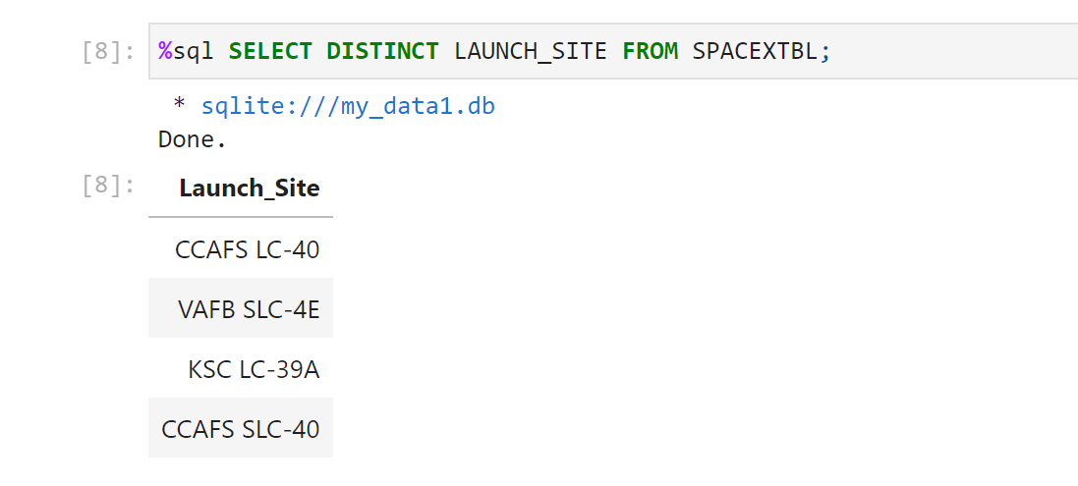
All Launch Site Names
The unique launch sites are

Slide 26
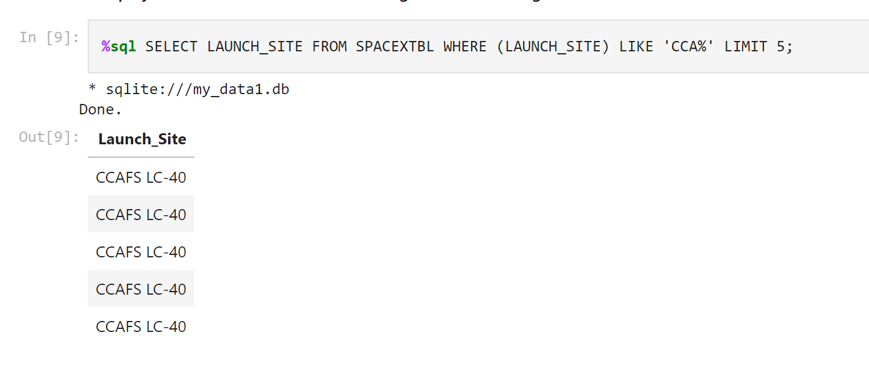
Launch Site Names Begin with 'CCA'
5 records where launch sites begin with `CCA`
5 records begin with ‘CCA’ are same in Launch Site “CCAFS LC-40”

Slide 27
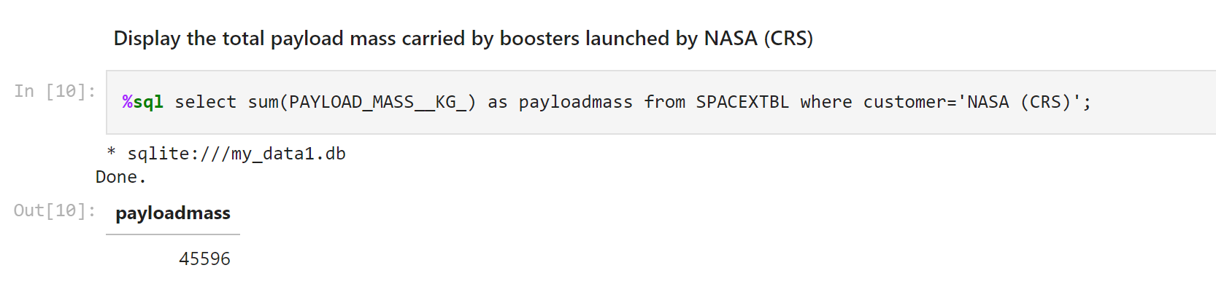
Total Payload Mass
Calculate the total payload carried by boosters from NASA
We calculated the total payload carried by boosters from NASA as 45596

Slide 28
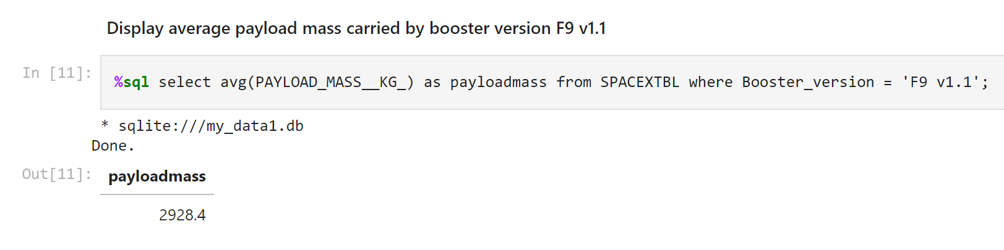
Average Payload Mass by F9 v1.1
The average payload mass carried by booster version F9 v1.1
We calculated the average payload mass carried by booster version F9 v1.1 as 2928.4

Slide 29
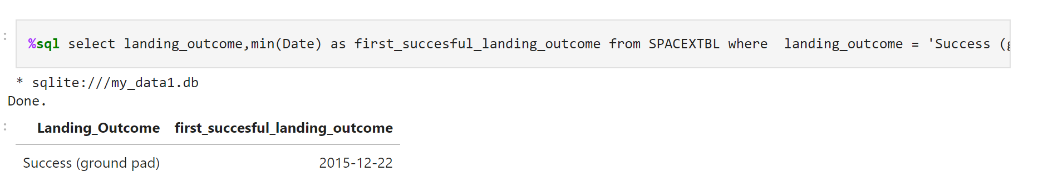
First Successful Ground Landing Date
The dates of the first successful landing outcome on ground pad
We observed that the dates of the first successful landing outcome on ground pad was 22nd December 2015

Slide 30
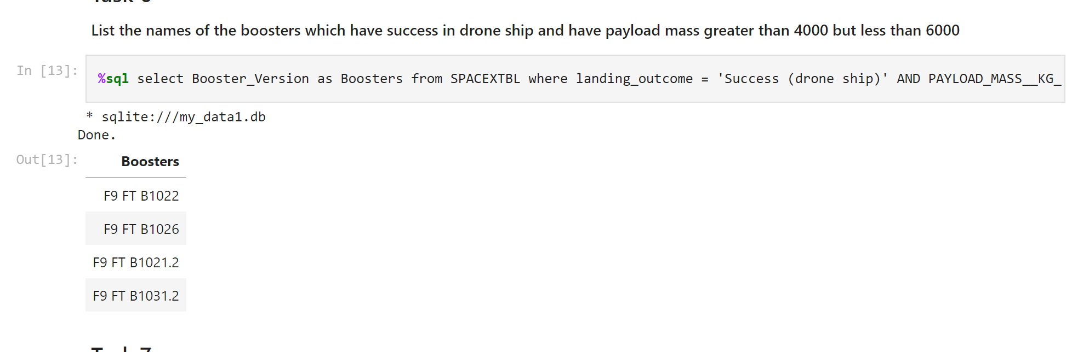
Successful Drone Ship Landing with Payload between 4000 and 6000
The names of boosters which have successfully landed on drone ship and had payload mass greater than 4000 but less than 6000
We used the WHERE clause to filter for boosters which have successfully landed on drone ship and applied the AND condition to determine successful landing with payload mass greater than 4000 but less than 6000

Slide 31
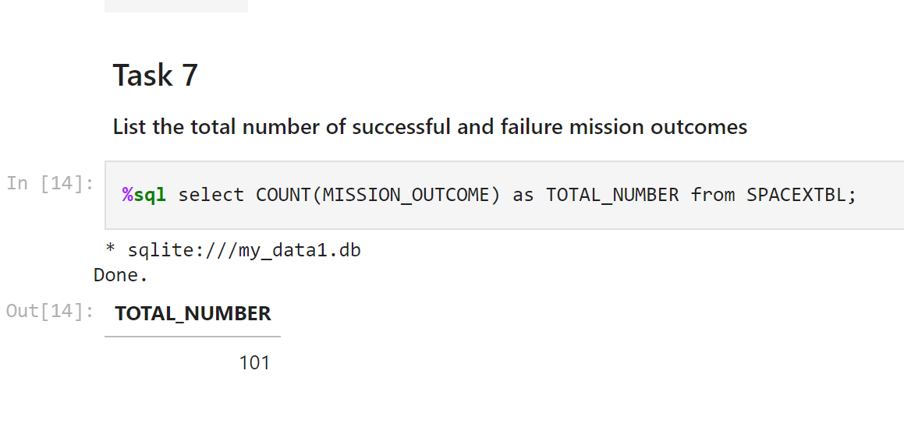
Total Number of Successful and Failure Mission Outcomes
The total number of successful and failure mission outcomes
We used wildcard like ‘%’ to filter for WHERE MissionOutcome was a success or a failure

Slide 32
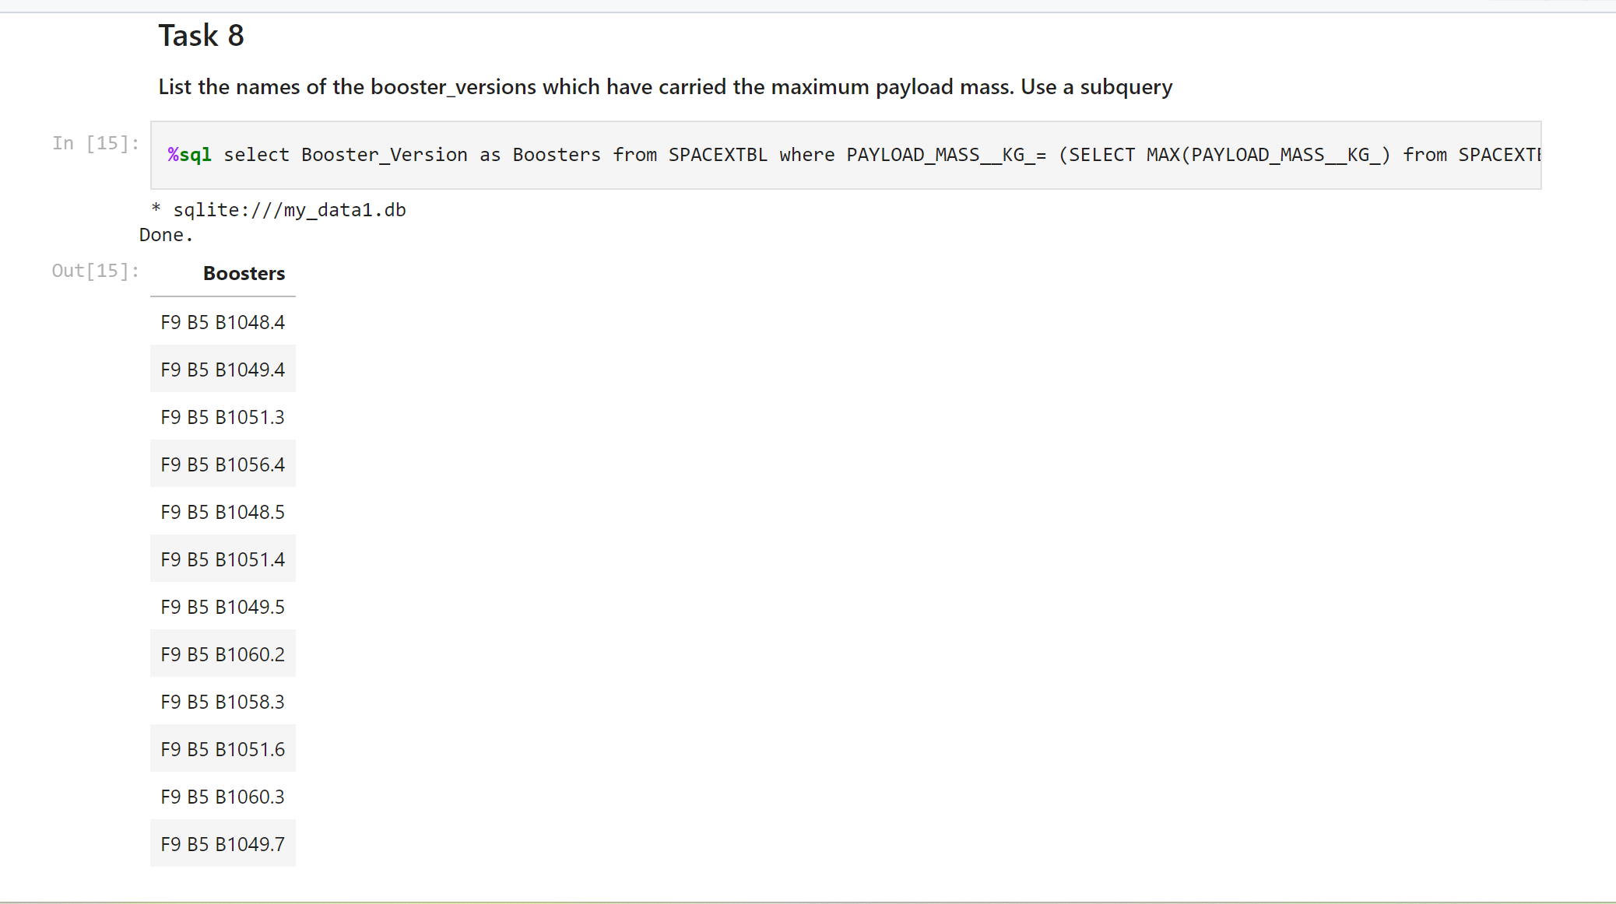
Boosters Carried Maximum Payload
The names of the booster which have carried the maximum payload mass

Slide 33
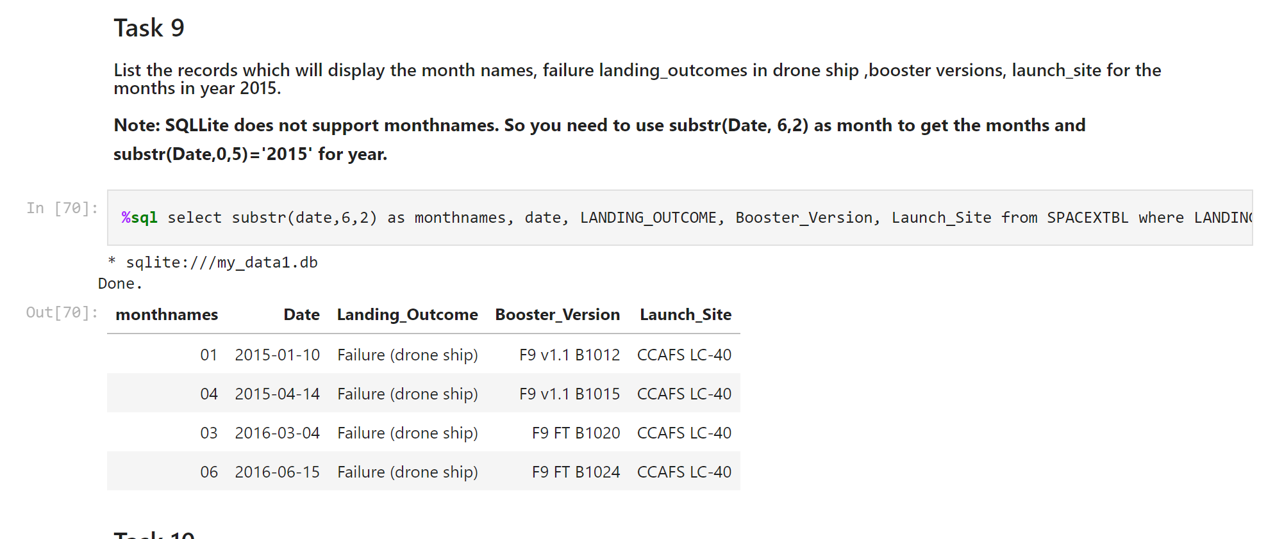
2015 Launch Records
The failed landing_outcomes in drone ship, their booster versions, and launch site names for in year 2015
Present your query result with a short explanation here

Slide 34
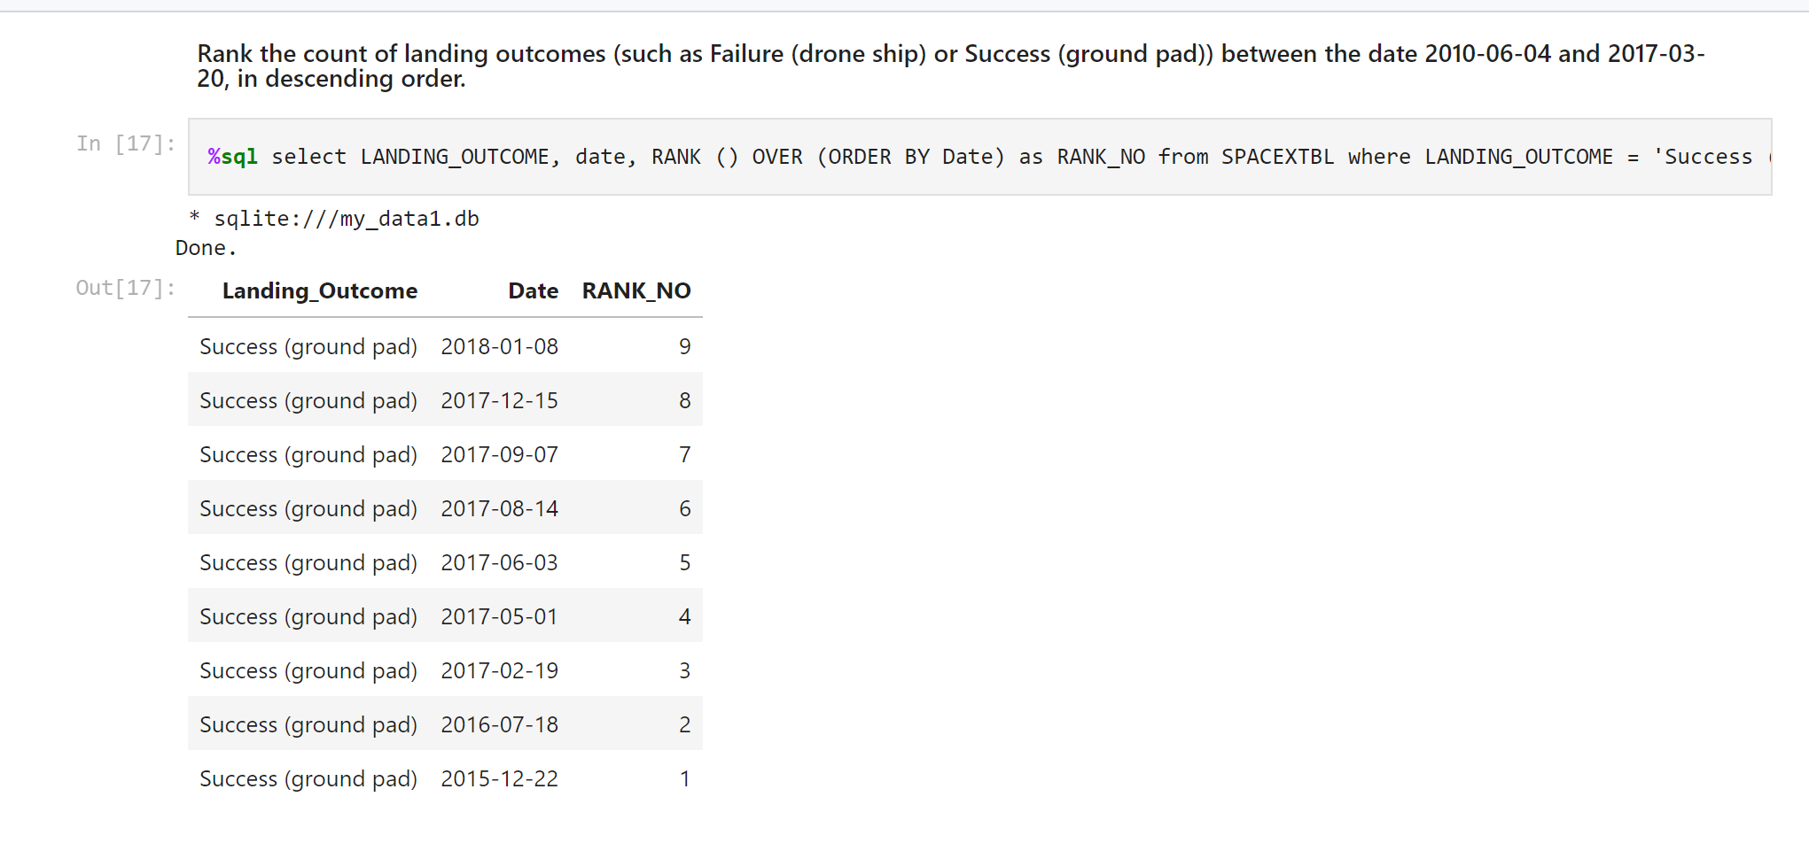
Rank Landing Outcomes Between 2010-06-04 and 2017-03-20
Rank the count of landing outcomes (such as Failure (drone ship) or Success (ground pad)) between the date 2010-06-04 and 2017-03-20, in descending order
Present your query result with a short explanation here

Slide 35

Section 3

Slide 36
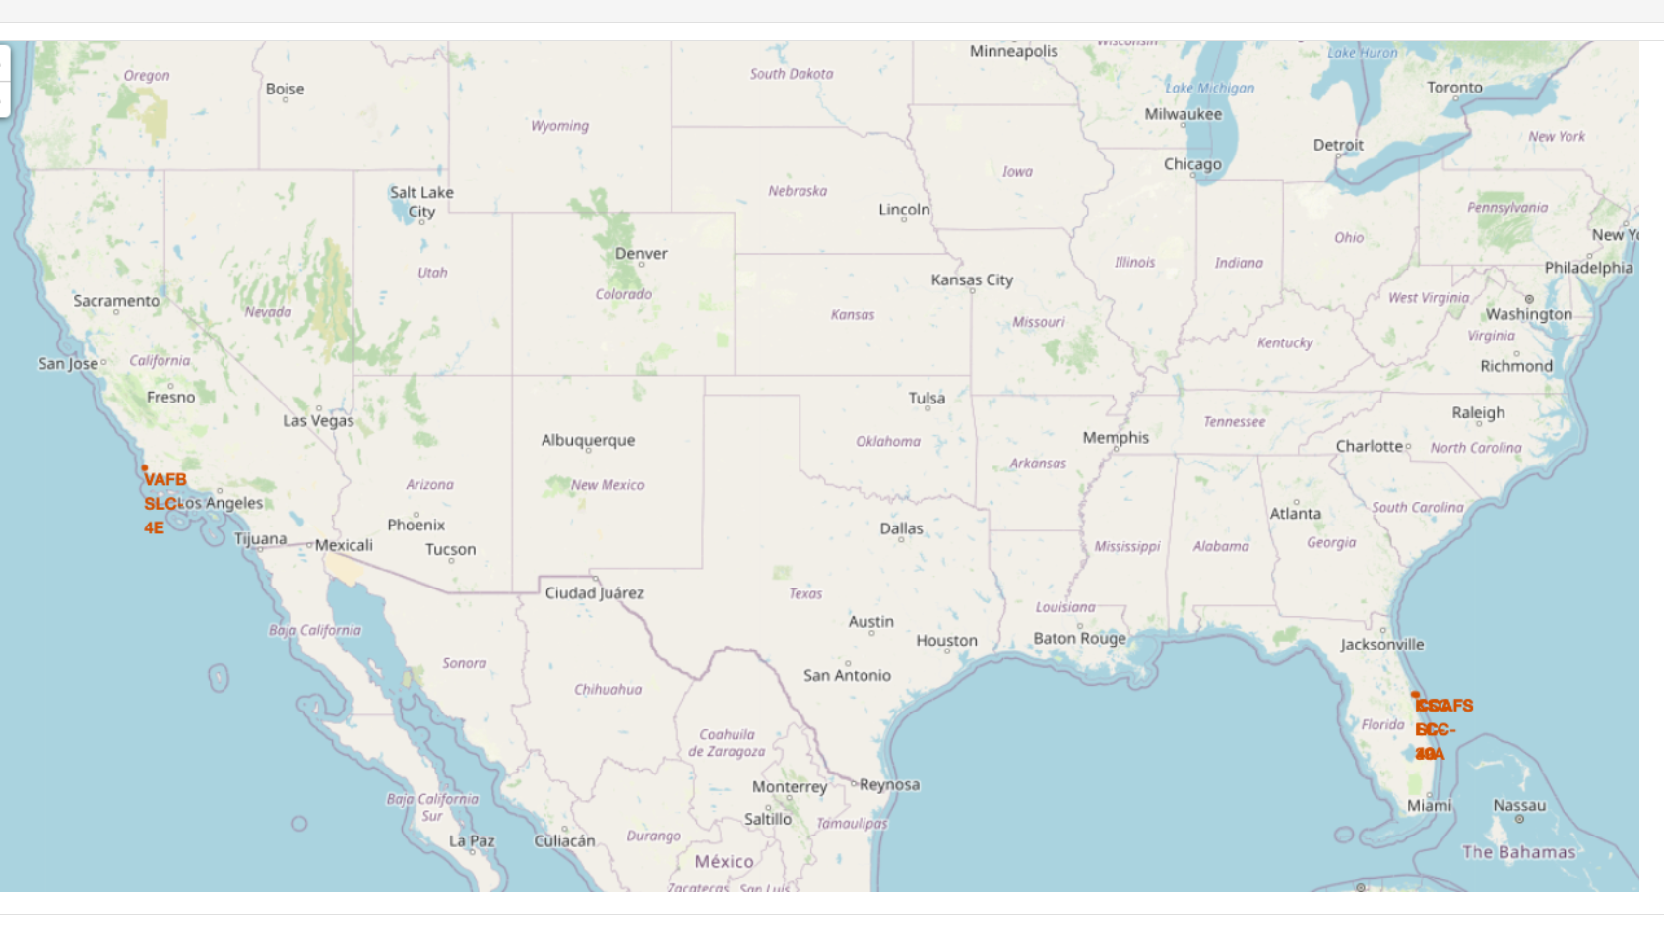
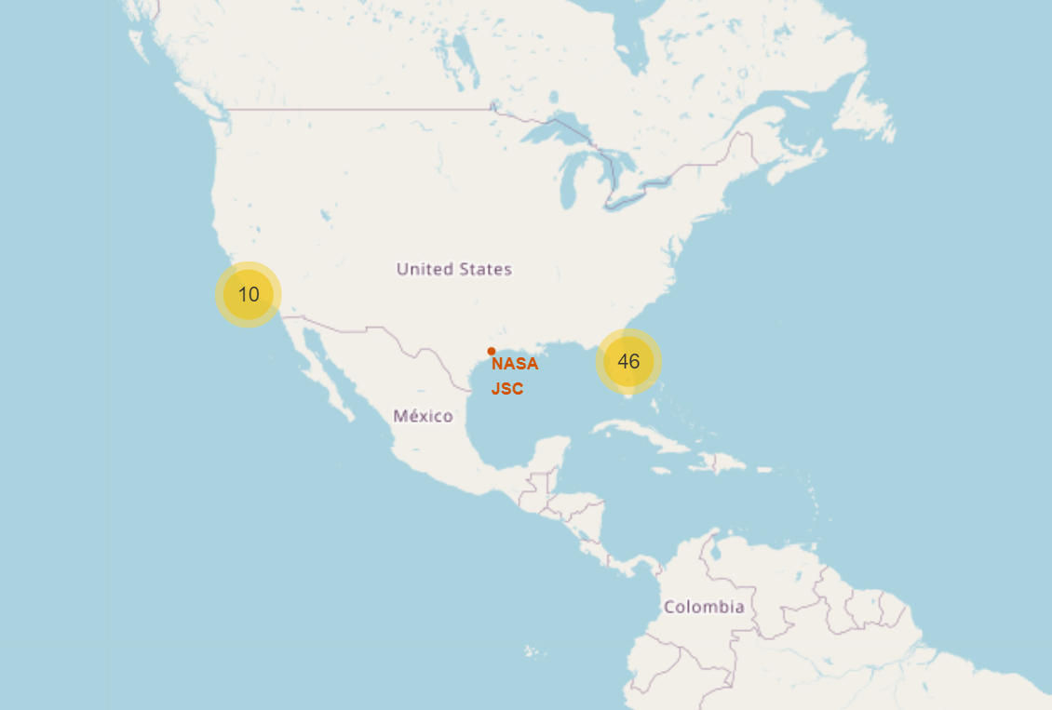
All launch sites global map markers
We can see all launch sites are in The United States of America Coast

Slide 37
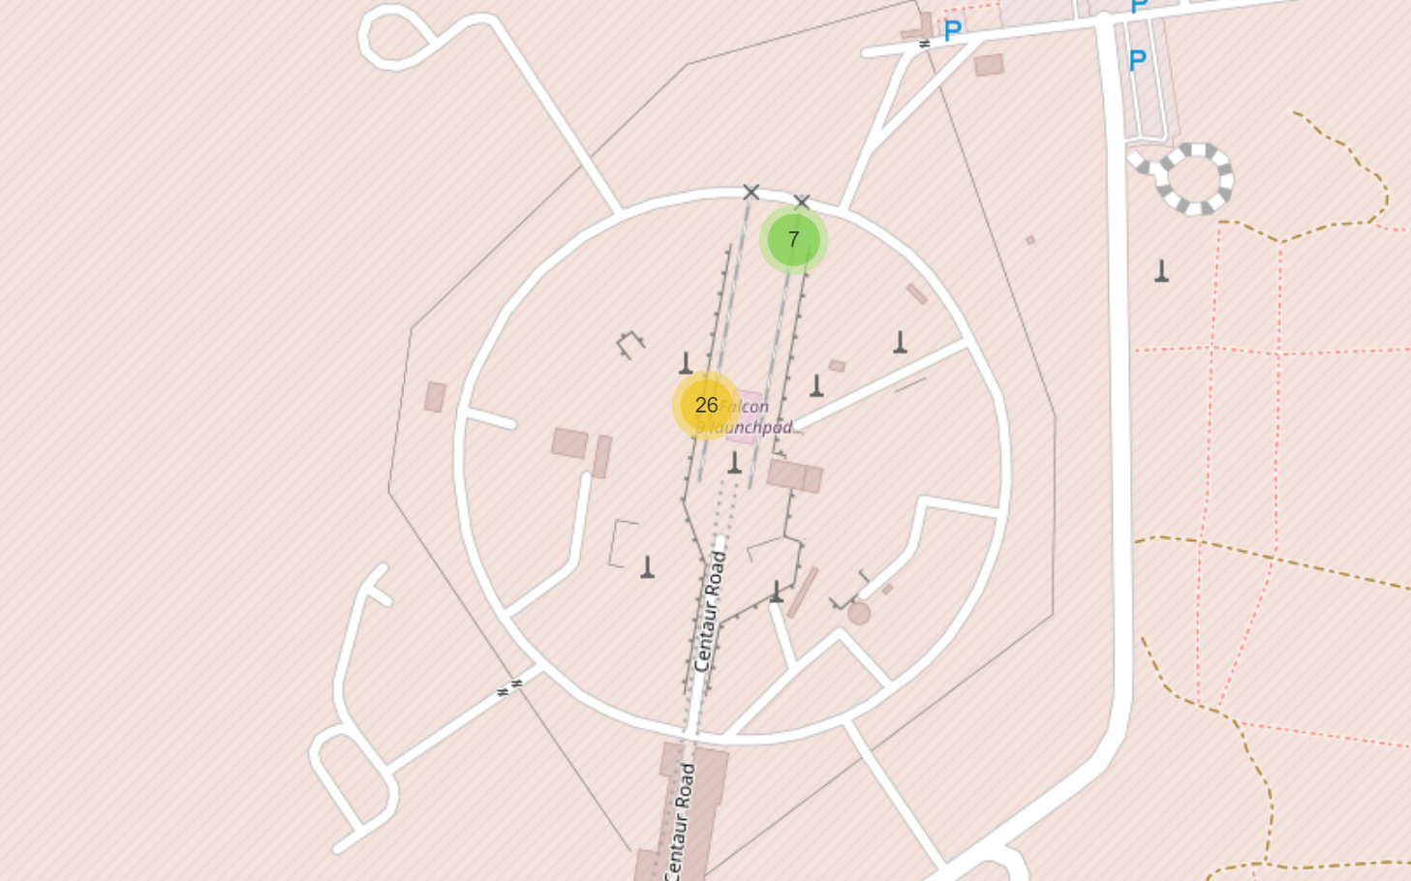
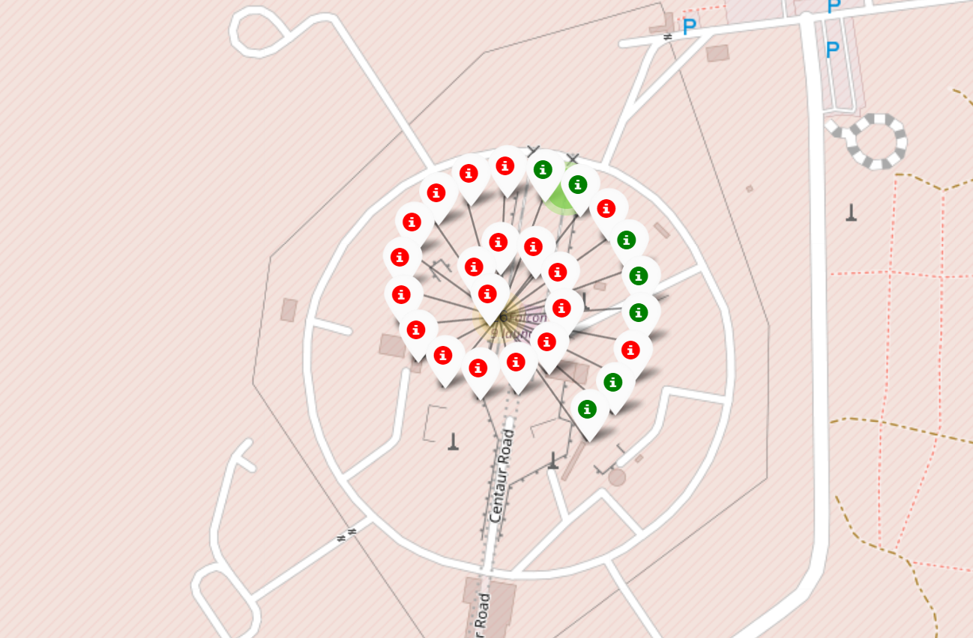
Markers showing launch sites with color labels
Red marker shows failer launches
Green marker shows successful launches

Slide 38
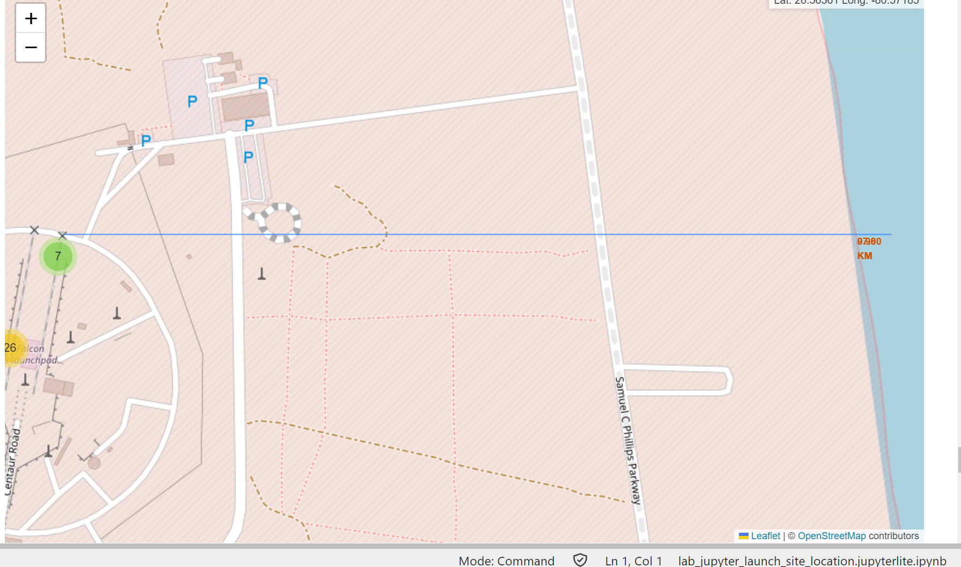
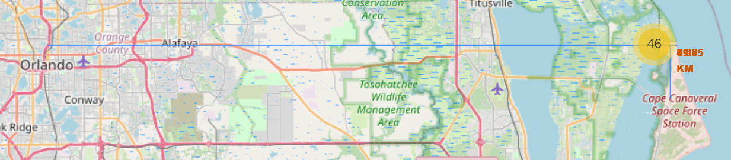
Launch Site distance to landmarks
Are launch sites in close proximity to railways? No
Are launch sites in close proximity to highways? No
Are launch sites in close proximity to coastline? Yes
Do launch sites keep certain distance away from cities? Yes

Slide 39

Section 4

Slide 40

Pie chart showing the success percentage achieved by each launch site

Slide 41

Pie chart showing the Launch site with the highest launch success ratio

Slide 42

Scatter plot of Payload vs Launch Outcome for all sites, with different payload selected in the range slider

Slide 43

Section 5

Slide 44
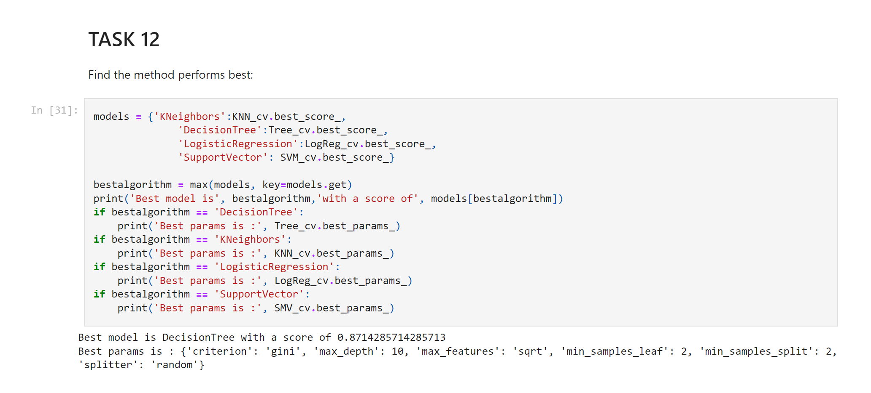
Classification Accuracy
Visualize the built model accuracy for all built classification models, in a bar chart
Find which model has the highest classification accuracy

Slide 45

Confusion Matrix
Show the confusion matrix of the best performing model with an explanation
The confusion matrix for the decision tree classifier shows that the classifier can distinguish between the different classes. The major problem is the false positives .i.e., unsuccessful landing marked as successful landing by the classifier.

Slide 46
Conclusions
We can conclude that:
The larger the flight amount at a launch site, the greater the success rate at a launch site.
Launch success rate started to increase in 2013 till 2020.
Orbits ES-L1, GEO, HEO, SSO, VLEO had the most success rate.
KSC LC-39A had the most successful launches of any sites.
The Decision tree classifier is the best machine learning algorithm for this task.

Slide 47
Appendix
https://github.com/truong-nha-binh/test-repo/blob/main/DV0101EN-Module4-Cheat-Sheet.pdf
https://github.com/truong-nha-binh/test-repo/blob/main/SQL%20CHEATSHEET.pdf
https://github.com/truong-nha-binh/test-repo/blob/main/dataset_part_1.csv
https://github.com/truong-nha-binh/test-repo/blob/main/dataset_part_2.csv
https://github.com/truong-nha-binh/test-repo/blob/main/dataset_part_3.csv

Slide 48


